Slide 1
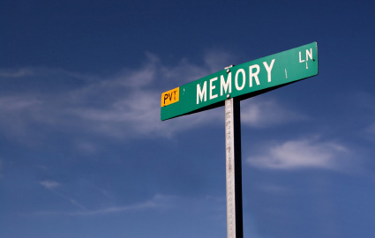
Treasure
Review

Slide 2

Deterministic Search Problems

Slide 3
Intuition
Describe how a computer
can try everything

Slide 4
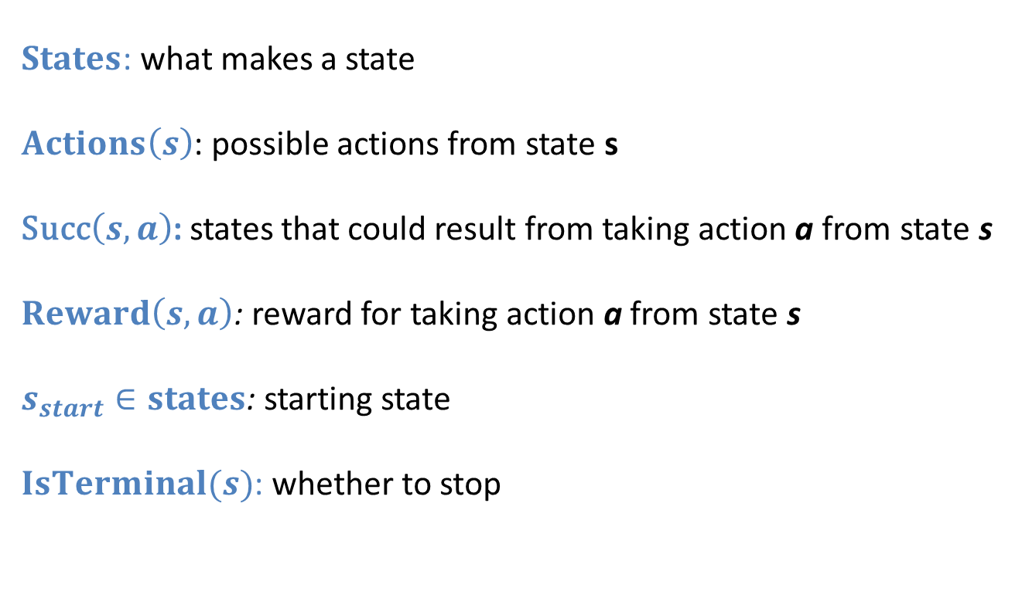
Modeling DSP
$States$: what makes a state
$Actions\left(s\right)$: possible actions from state s
Succ$\left(s, a\right)$: states that could result from taking action a from state s
$Reward\left(s, a\right)$: reward for taking action a from state s
$s_{start}∈states$: starting state
$IsTerminal(s)$: whether to stop

Slide 5
Breadth First Search
fringe = Queue()
fringe.enqueue(startState)
visited = Set([])
while not fringe.isEmpty():
currState = fringe.dequeue()
if not currState in visited:
visited.add(currState)
if isTerminal(currState) return currState
for nextState in getNextStates(currState) fringe.enqueue(nextState)

Slide 6
Depth First Search
fringe = Queue()
fringe.push(startState)
visited = Set([])
while not fringe.isEmpty():
currState = fringe.pop()
if not currState in visited:
visited.add(currState)
if isTerminal(currState) return currState
for nextState in getNextStates(currState) fringe.push(nextState)

Slide 7

DNA Alignment
ATTGGGAAATGCCCCATTATTBBC
ATTGGAATCGACATATTATTBBC

Slide 8
DNA Alignment
ATTATCCA
TTGCATGCA
ATT__ATCCA
_TTGCATGCA

Slide 9
DNA Alignment
State:
ATTATCCA
TTGCATGCA

Slide 10
DNA Alignment
Start State:
ATTATCCA
TTGCATGCA

Slide 11
DNA Alignment
ATTATCCA
TTGCATGCA
Actions:
Put a gap infront of the 1st cursor
Put a gap infront of the 2nd cursor
Match the letters at the cursors

Slide 12
DNA Alignment
ATTATCCA
TTGCATGCA
Successors:
Put a gap infront of the 1st cursor
Advance 2nd cursor
Put a gap infront of the 2nd cursor
Advance 1st cursor
Match the letters at the cursors
Move both cursors

Slide 13
DNA Alignment
ATTATCCA
TTGCATGCA
Cost:
Put a gap infront of the 1st cursor
2
Put a gap infront of the 2nd cursor
2
Match the letters at the cursors
0 if match 1 if !match

Slide 14
DNA Alignment
Goal Test:
ATT__ATCCA
_TTGCATGCA

Slide 15

Did We Break BFS?

Slide 16

Starting Line

Slide 17


CS221: More Intelligent Search

Slide 18

Uniformed Cost Search
A Star
Markov Decision Problems

Slide 19
Uniformed Cost Search
A Star
Markov Decision Problems

Slide 20

My Hobby

Slide 21
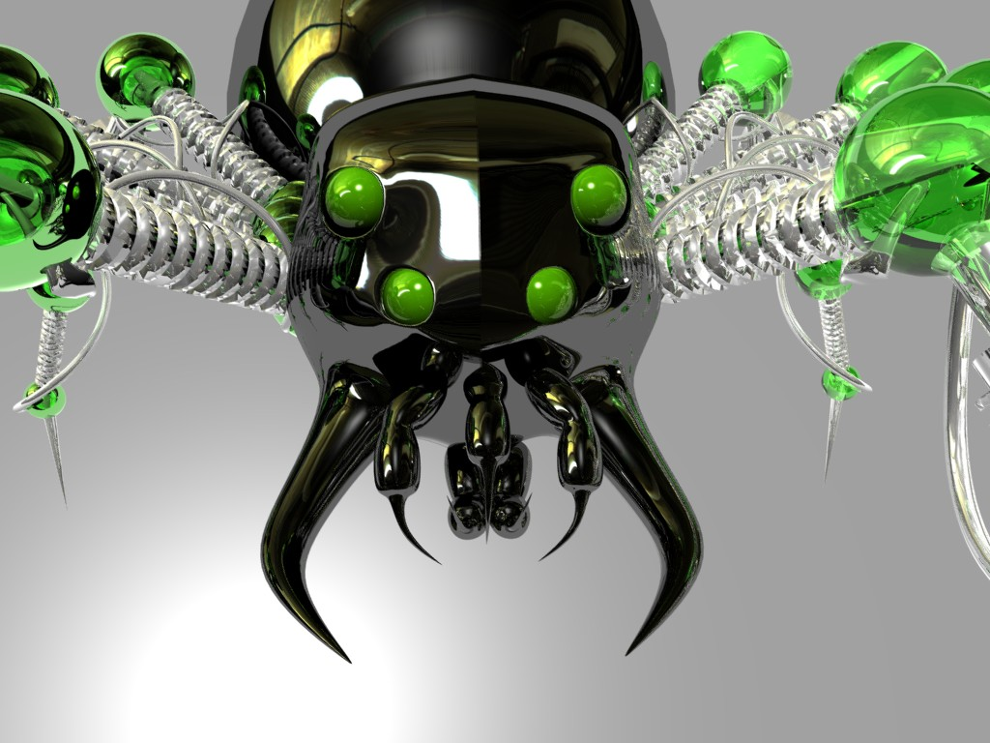
Internet

Slide 22
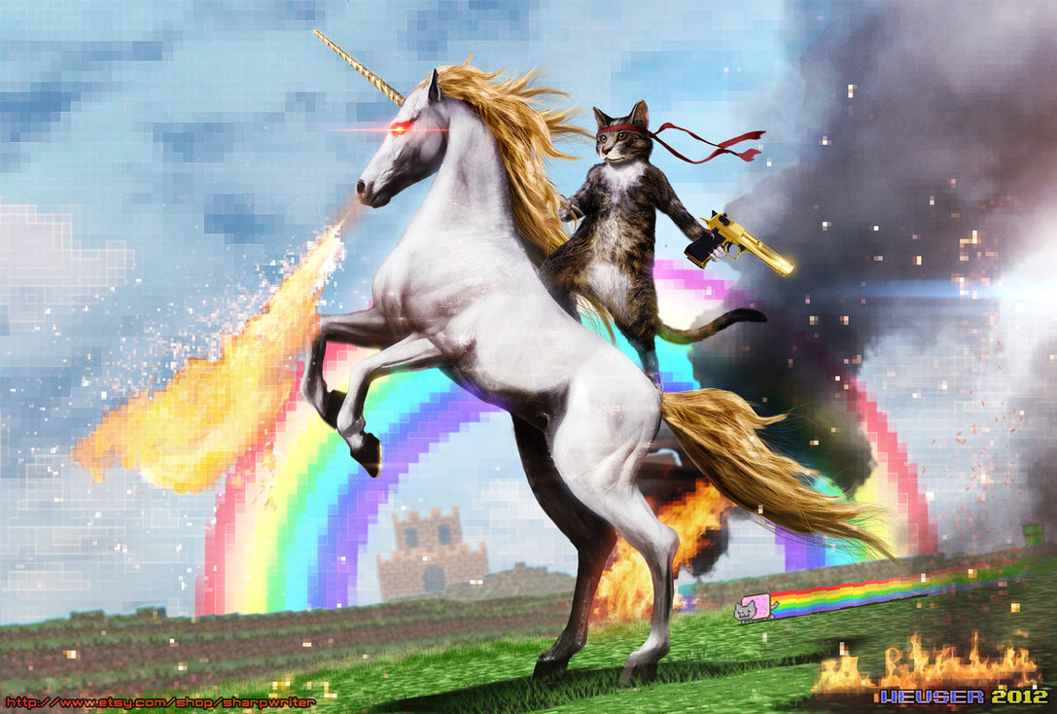
Internet

Slide 23
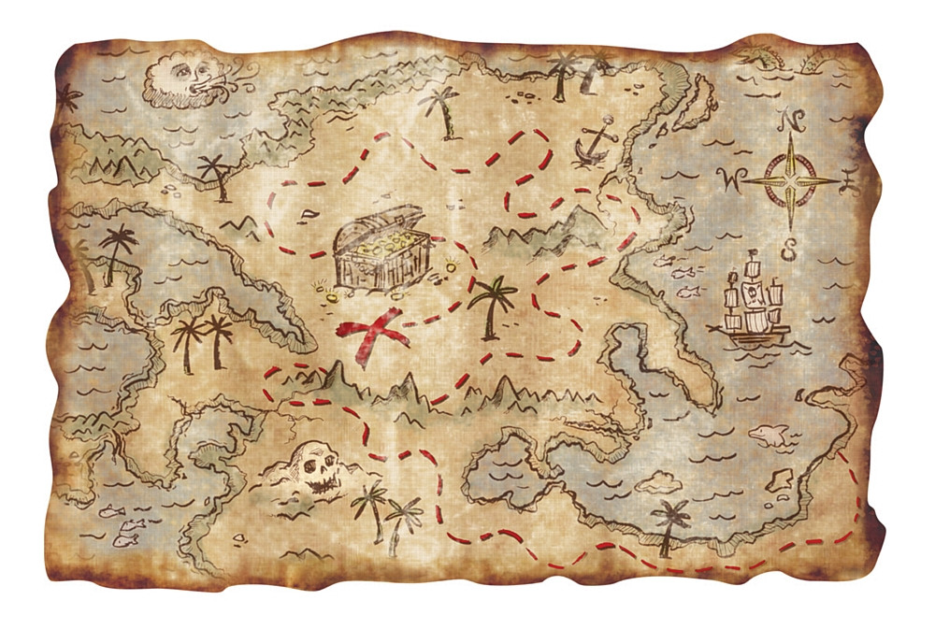
Treasure
Treasure Map

Slide 24
Depth First Search
fringe = Queue()
fringe.push(startState)
visited = Set([])
while not fringe.isEmpty():
currState = fringe.pop()
if not currState in visited:
visited.add(currState)
if isTerminal(currState) return currState
for nextState in getNextStates(currState) fringe.push(nextState)

Slide 25
Breadth First Search
fringe = Queue()
fringe.enqueue(startState)
visited = Set([])
while not fringe.isEmpty():
currState = fringe.dequeue()
if not currState in visited:
visited.add(currState)
if isTerminal(currState) return currState
for nextState in getNextStates(currState) fringe.enqueue(nextState)

Slide 26
Breadth First Search
fringe = Queue()
fringe.enqueue(startState)
visited = Set([])
while not fringe.isEmpty():
currState = fringe.dequeue()
if not currState in visited:
visited.add(currState)
if isTerminal(currState) return currState
for nextState in getNextStates(currState) fringe.enqueue(nextState)

Slide 27
UCS Search
fringe = PriorityQueue()
fringe.enqueue(startState, 0)
visited = Set([])
while not fringe.isEmpty():
currState = fringe.dequeue()
if not currState in visited:
visited.add(currState)
if isTerminal(currState) return currState
for nextState in getNextStates(currState)
costSoFar = nextState.getCostSoFar()
fringe.enqueue(nextState, costSoFar)

Slide 28
UCS Search
Proposition: UCS terminates with an optimal path
If there are no negative cost edges, path costs of expanded node monotonically increase

Slide 29
UCS Search
Proposition: UCS terminates with an optimal path
Goal
Start
Explored

Slide 30
Uniformed Cost Search
A Star
Markov Decision Problems

Slide 31
Uniformed Cost Search
A Star
Markov Decision Problems

Slide 32

Exponential

Slide 33
Insight…
Goal
Start

Slide 34
Insight…
Goal
Start

Slide 35
Insight…
Goal
Start

Slide 36
Insight…
Goal
Start

Slide 37
Insight…
Really?
Goal
Start

Slide 38
Insight…
Really?
Goal
Start

Slide 39
Lets put in an estimate?
Really?
Goal
Start

Slide 40
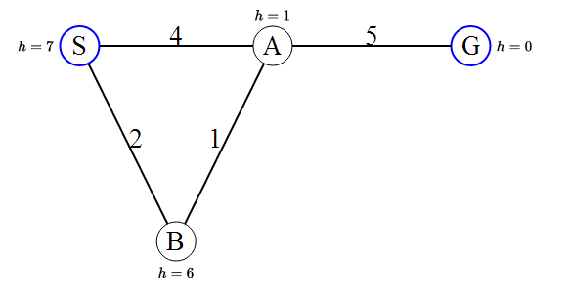
Will that always work?
No.

Slide 41
Lets put in an underestimate?
Really?
Goal
Start

Slide 42
Will that always work?
Terminology:
C( )
True cost from node to goal
H( )
Heuristic cost from node to goal
G( )
Actual cost from start to node
F( )
G( ) + H( )

Slide 43
Will that always work?
Terminology:
C( )
Goal
Start
H( )
G( )

Slide 44
Will that always work?
Proof by contradiction:
Goal 1
Start
n
Goal 2

Slide 45
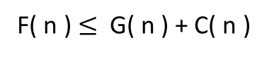
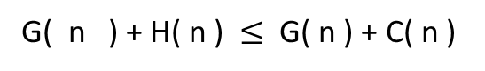
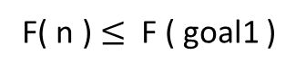
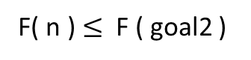
Will that always work?
F( goal1 ) = G( goal1 )
Since H ( goal ) = 0
Goal 1
F( goal2 ) = G( goal2 )
Since H ( goal ) = 0
Start
G( goal1 ) > G( goal2 )
Since goal 1 is sub opt.
n
Goal 2
H( n ) < C( n )
Since H is underestimate.
F( goal1 ) > F( goal2 )
Putting first three lines together
G( n ) + H( n ) $≤$ G( n ) + C( n )
Because of line 4
F( n ) $≤$ G( n ) + C( n )
By the definition of F( n )
F( n ) $≤$ F ( goal2 )
By the definition of F( goal2 )
F( n ) $≤$ F ( goal1 )
From line 5
Which is a contradiction

Slide 46

Just Relax

Slide 47
UCS Search
fringe = PriorityQueue()
fringe.enqueue(startState, 0)
visited = Set([])
while not fringe.isEmpty():
currState = fringe.dequeue()
if not currState in visited:
visited.add(currState)
if isTerminal(currState) return currState
for nextState in getNextStates(currState)
costSoFar = nextState.getCostSoFar()
fringe.enqueue(nextState, costSoFar)

Slide 48
A Star
fringe = PriorityQueue()
fringe.enqueue(startState, heuristicCost(startState))
visited = Set([])
while not fringe.isEmpty():
currState = fringe.dequeue()
if not currState in visited:
visited.add(currState)
if isTerminal(currState) return currState
for nextState in getNextStates(currState)
costSoFar = nextState.getCostSoFar()
h = heuristicCost(nextState)
fringe.enqueue(nextState, costSoFar + h)

Slide 49
Observation
fringe = PriorityQueue()
fringe.enqueue(startState, heuristicCost(startState))
visited = Set([])
while not fringe.isEmpty():
currState = fringe.dequeue()
if not currState in visited:
visited.add(currState)
if isTerminal(currState) return currState
for nextState in getNextStates(currState)
costSoFar = nextState.getCostSoFar()
h = heuristicCost(nextState)
fringe.enqueue(nextState, costSoFar + h)
fringe = PriorityQueue()
fringe.enqueue(startState, 0)
visited = Set([])
while not fringe.isEmpty():
currState = fringe.dequeue()
if not currState in visited:
visited.add(currState)
if isTerminal(currState) return currState
for nextState in getNextStates(currState)
costSoFar = nextState.getCostSoFar()
fringe.enqueue(nextState, costSoFar)

Slide 50
Observation
fringe = PriorityQueue()
fringe.enqueue(startState, 0)
visited = Set([])
while not fringe.isEmpty():
currState = fringe.dequeue()
if not currState in visited:
visited.add(currState)
if isTerminal(currState) return currState
for nextState in getNextStates(currState)
costSoFar = nextState.getCostSoFar()
h = 0
fringe.enqueue(nextState, costSoFar + h)
fringe = PriorityQueue()
fringe.enqueue(startState, 0)
visited = Set([])
while not fringe.isEmpty():
currState = fringe.dequeue()
if not currState in visited:
visited.add(currState)
if isTerminal(currState) return currState
for nextState in getNextStates(currState)
costSoFar = nextState.getCostSoFar()
fringe.enqueue(nextState, costSoFar)

Slide 51
The 8 Puzzle

Slide 52
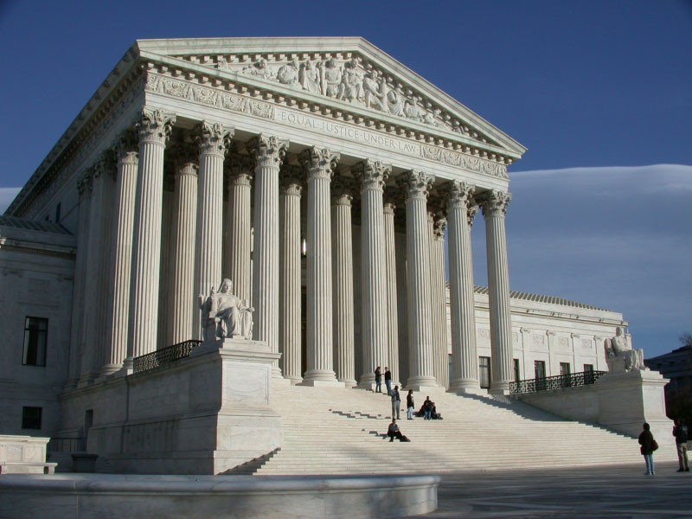
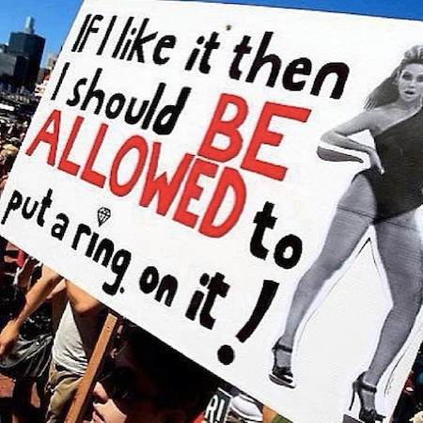
The 8 Puzzle

Slide 53
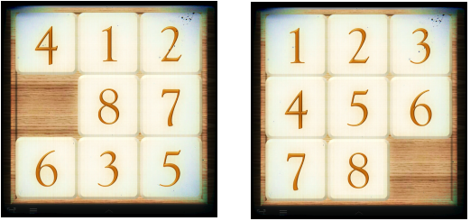
The 8 Puzzle

Slide 54
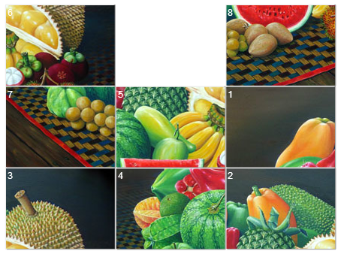
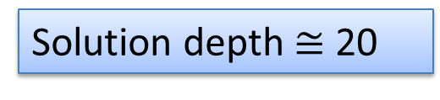
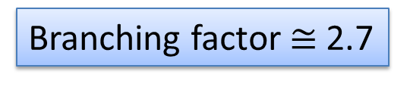
The 8 Puzzle
Solution depth $≅$ 20
Branching factor $≅$ 2.7
http://mypuzzle.org/sliding

Slide 55
A Star Wins
Demo

Slide 56
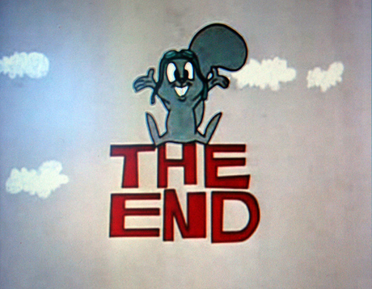
For Deterministic Search Problems

Slide 57
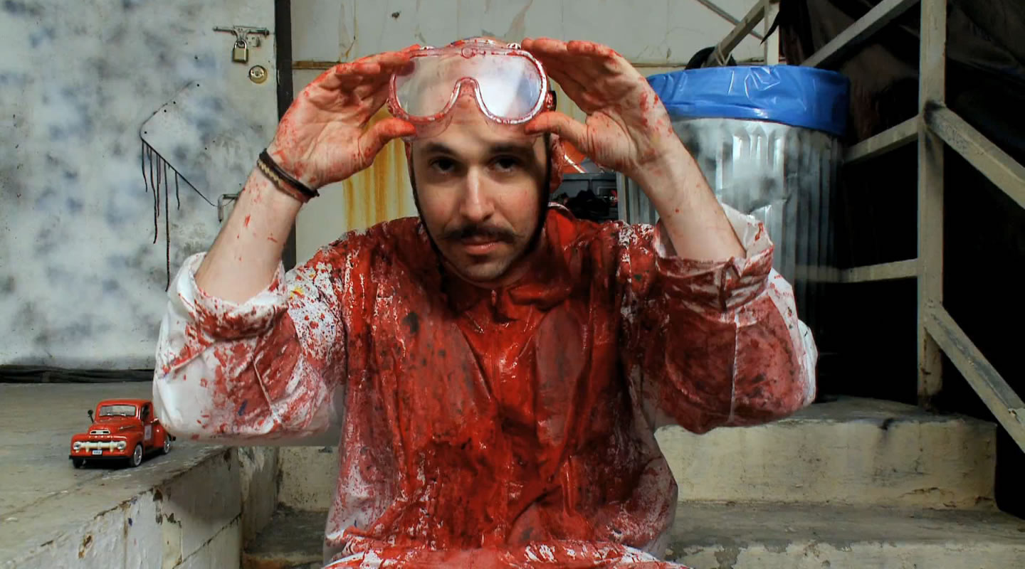
Intermission
https://www.youtube.com/watch?v=qybUFnY7Y8w

Slide 58
Uniformed Cost Search
A Star
Markov Decision Problems

Slide 59
Uniformed Cost Search
A Star
Markov Decision Problems

Slide 60

Markov Decision Problems

Slide 61

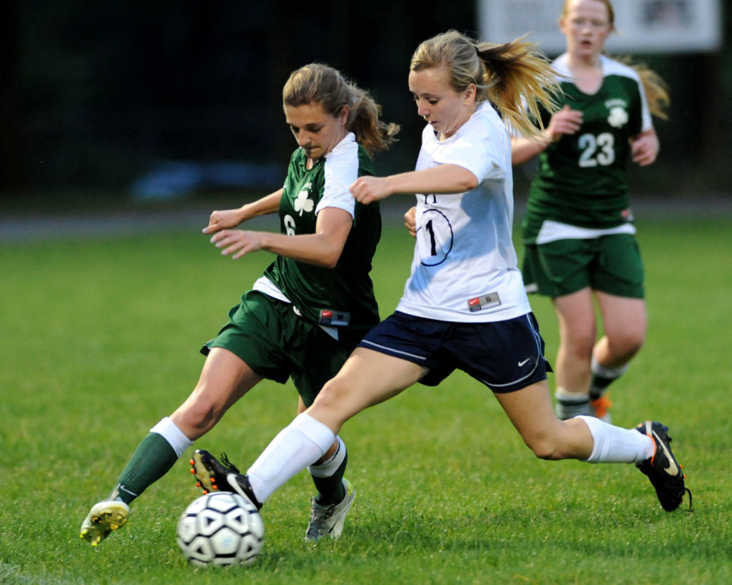
Deterministic State Problems
No Uncertainty
Discretized

Slide 62
Nondeterministic State Problems
Discretized

Slide 63
Markov Decision Problems
Discretized

Slide 64
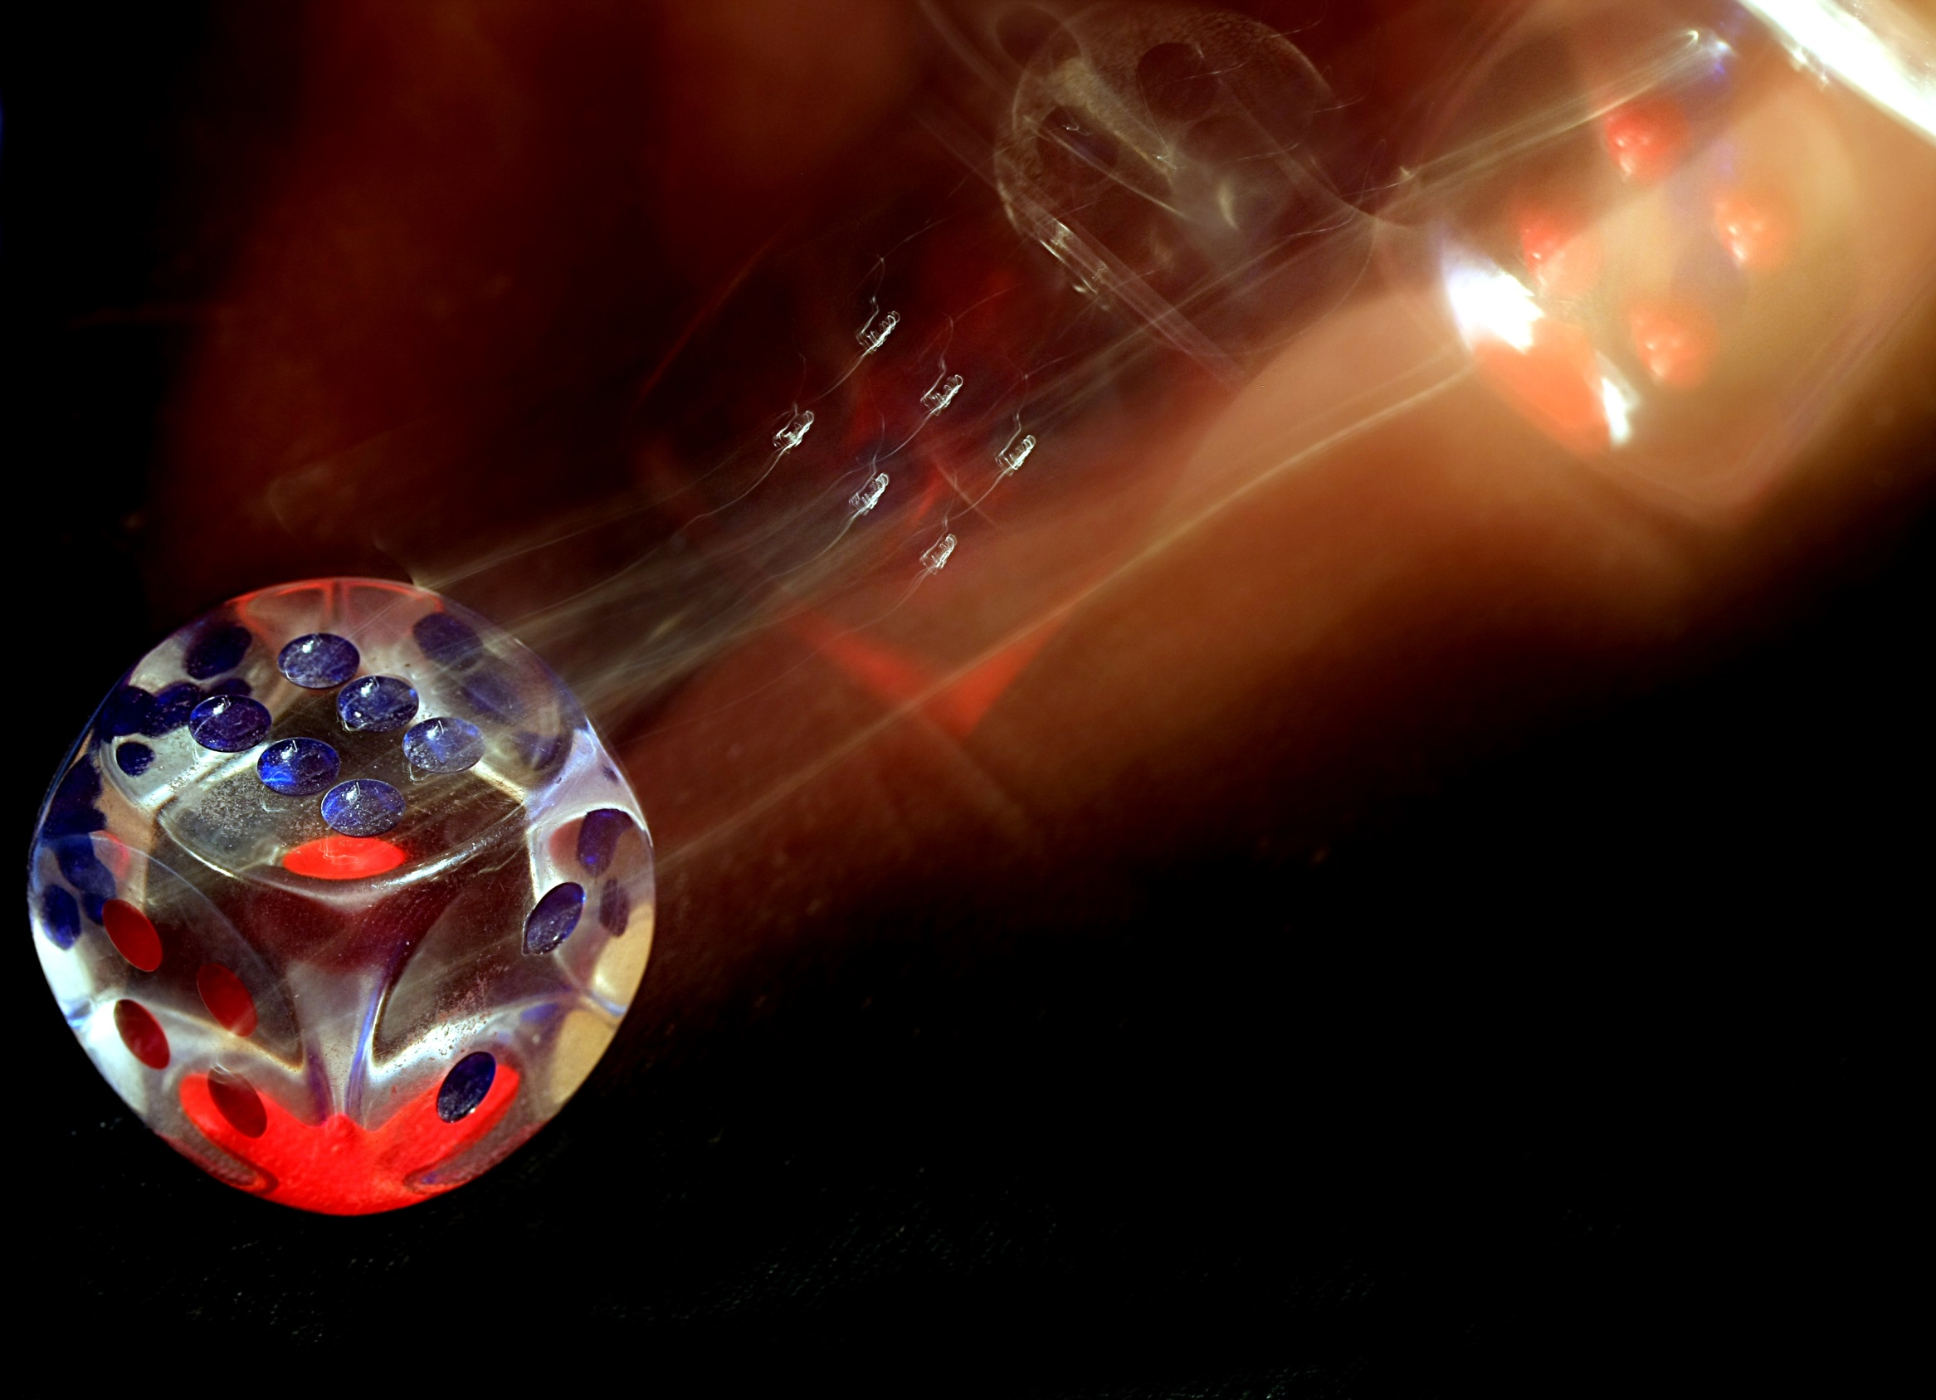
Expectation

Slide 65
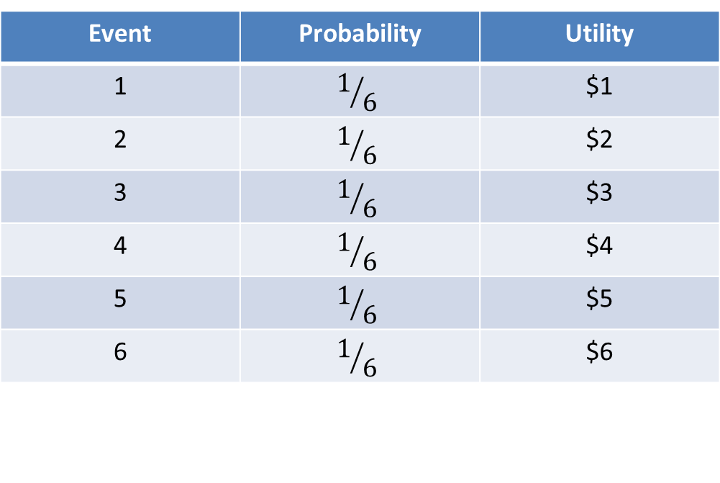
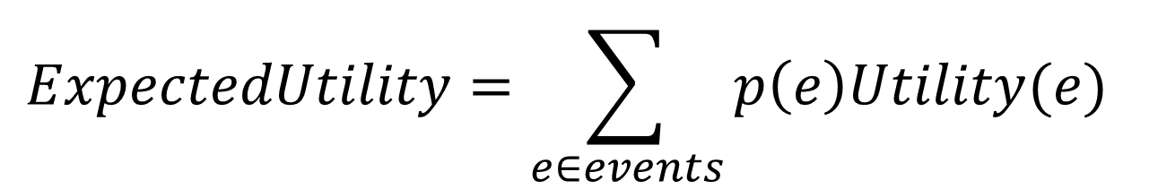
Expectation
$$ExpectedUtility=\sum_{e∈events}{p\left(e\right)Utility(e)}$$
Event | Probability | Utility
1 | $$1/6$$ | $1
2 | $$1/6$$ | $2
3 | $$1/6$$ | $3
4 | $$1/6$$ | $4
5 | $$1/6$$ | $5
6 | $$1/6$$ | $6
0.17
0.33
0.50
0.66
0.83
1.00
$3.50

Slide 66

Volunteer

Slide 67
Markov Decision Problems
Discretized

Slide 68
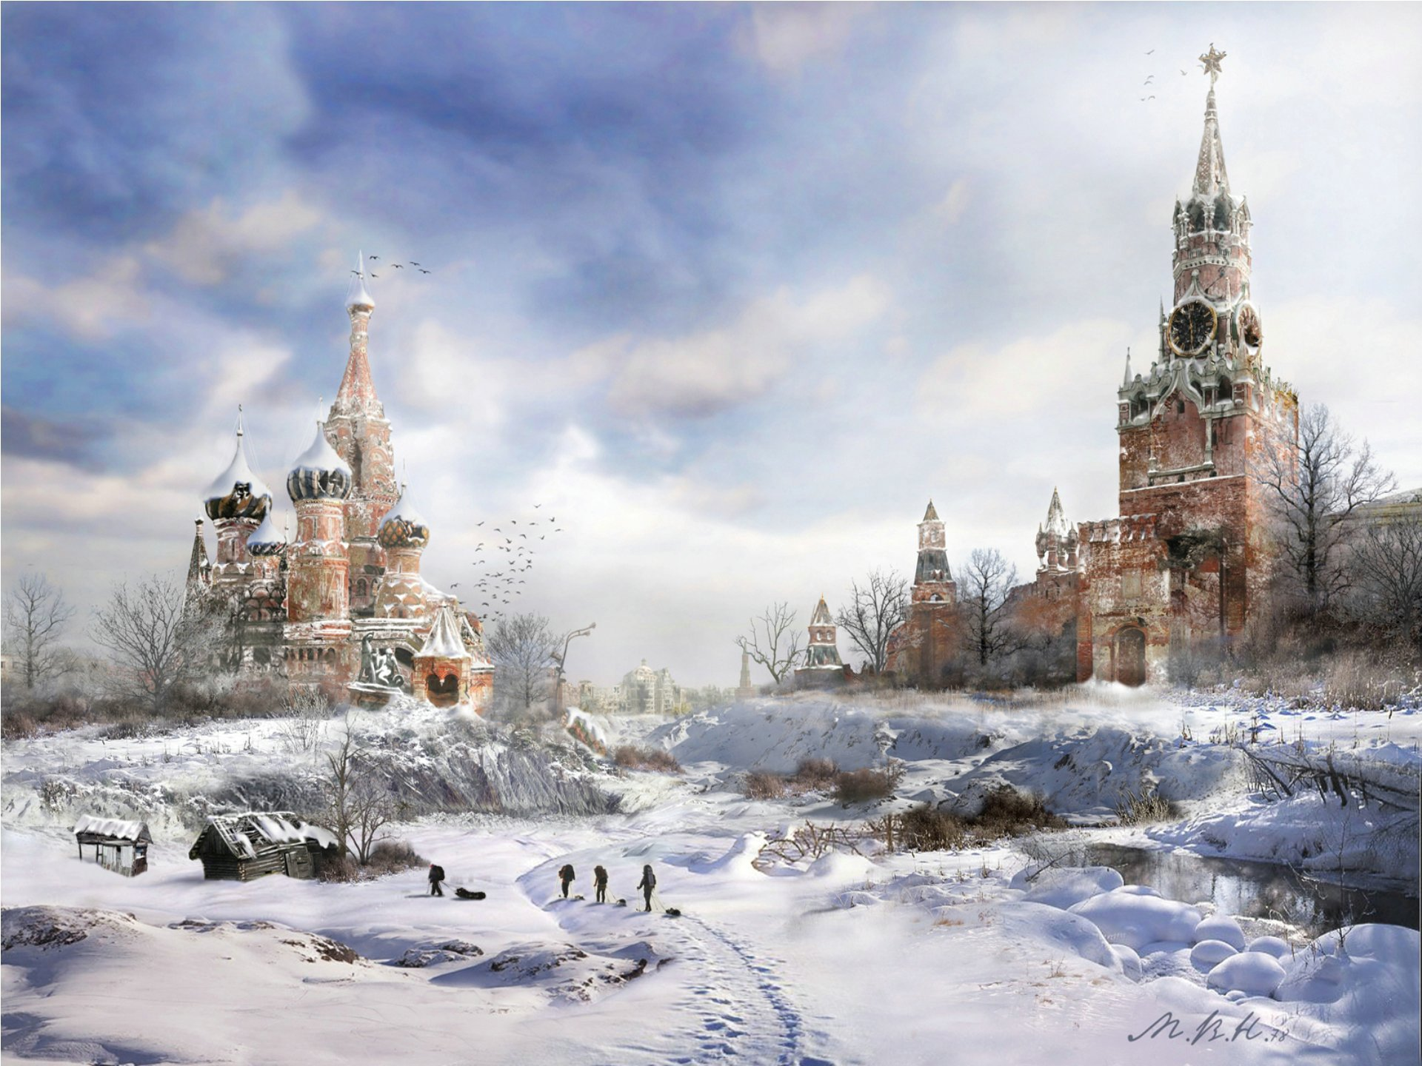
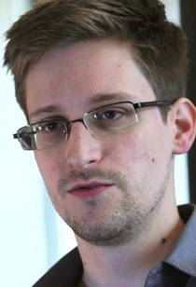
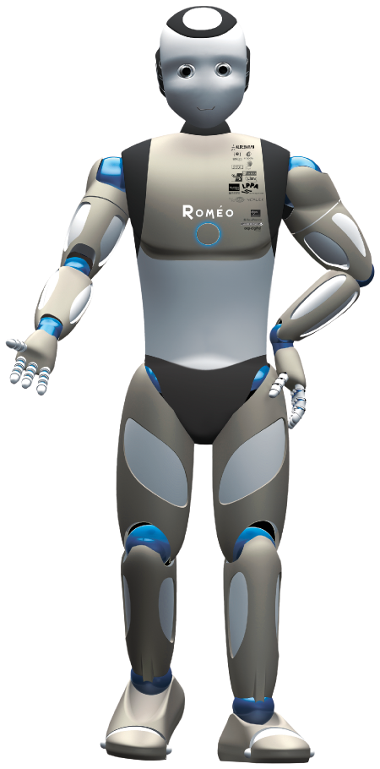

Slide 69
Snowden MDP
Hong Kong
Fly to Moscow
Fly to US
US
Moscow
US

Slide 70
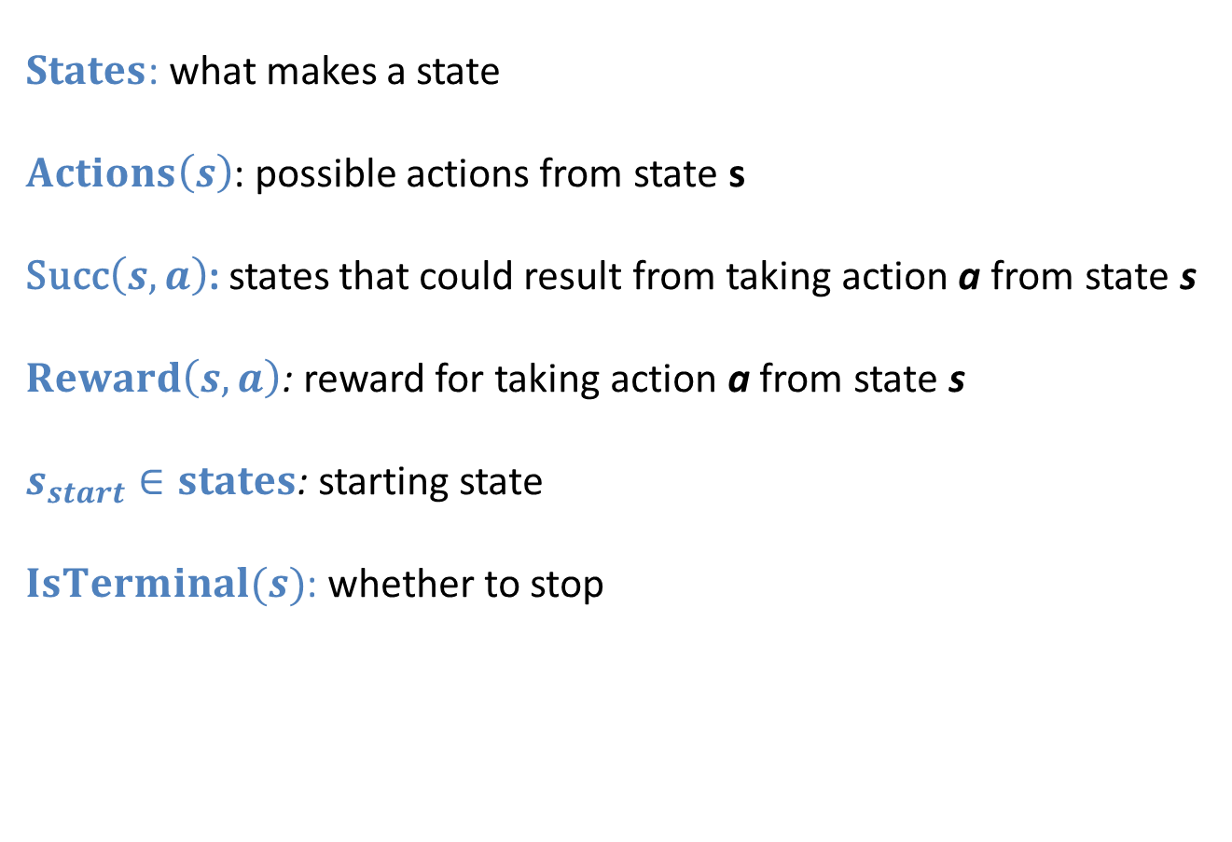
Modeling Discrete Search
$States$: what makes a state
$Actions\left(s\right)$: possible actions from state s
Succ$\left(s, a\right)$: states that could result from taking action a from state s
$Reward\left(s, a\right)$: reward for taking action a from state s
$s_{start}∈states$: starting state
$IsTerminal(s)$: whether to stop

Slide 71
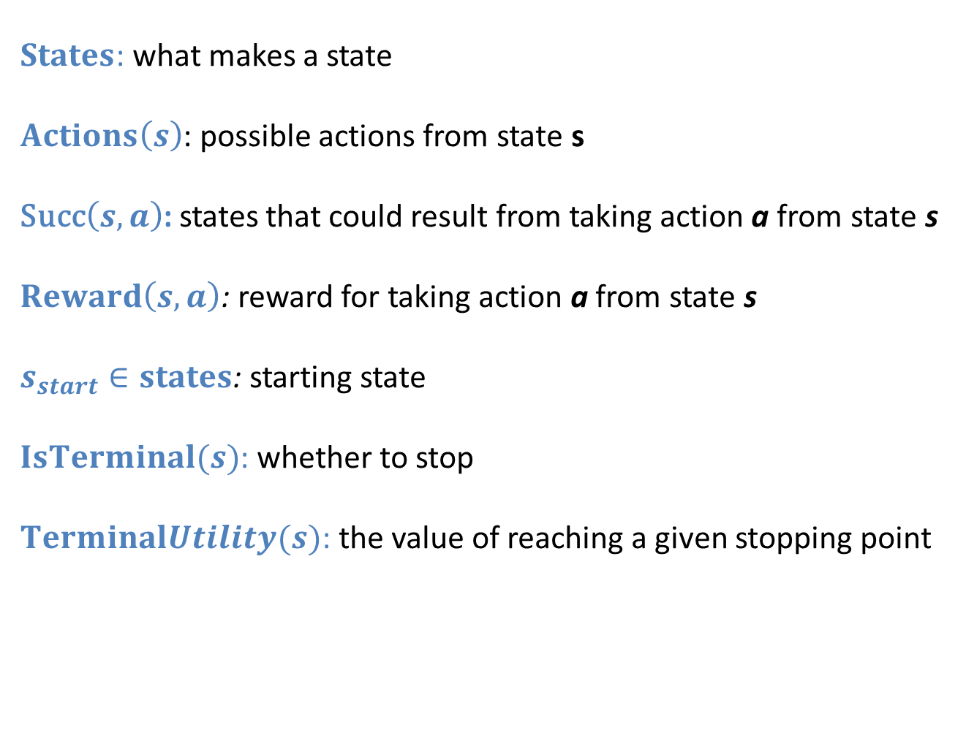
Modeling Discrete Search
$States$: what makes a state
$Actions\left(s\right)$: possible actions from state s
Succ$\left(s, a\right)$: states that could result from taking action a from state s
$Reward\left(s, a\right)$: reward for taking action a from state s
$s_{start}∈states$: starting state
$IsTerminal(s)$: whether to stop
$TerminalUtility(s)$: the value of reaching a given stopping point

Slide 72
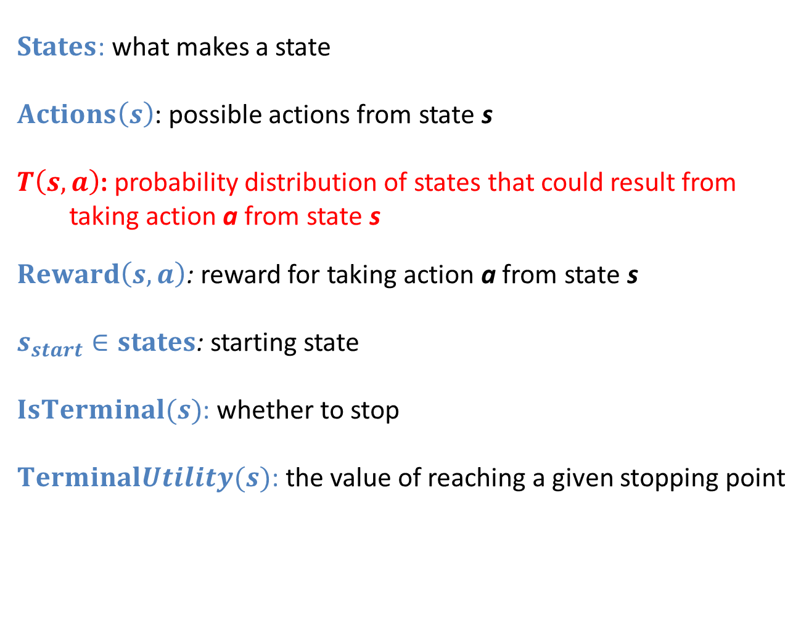
Modeling Markov Decision
$States$: what makes a state
$Actions\left(s\right)$: possible actions from state s
$T\left(s, a\right)$: probability distribution of states that could result from taking action a from state s
$Reward\left(s, a\right)$: reward for taking action a from state s
$s_{start}∈states$: starting state
$IsTerminal(s)$: whether to stop
$TerminalUtility(s)$: the value of reaching a given stopping point

Slide 73
Algorithm?
Hong Kong
getAction
expectedUtility
Fly to Moscow
Fly to US
expectedUtility
expectedUtility
US
Moscow
US
expectedUtility
expectedUtility

Slide 74
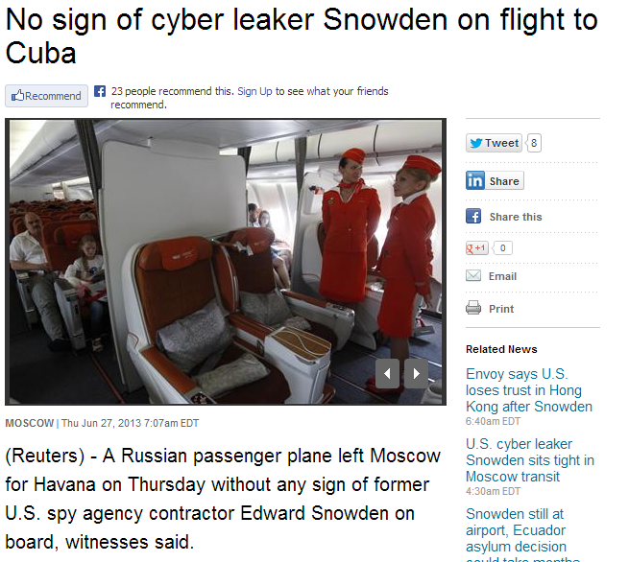
Slow Expectimax?

Slide 75
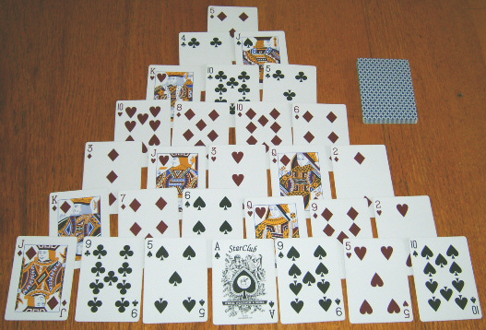
Pyramid Solitaire

Slide 76
Uniform Cost Search

Slide 77
Heuristics and A*

Slide 78
Building in Uncertainty

Slide 79
End.
(go do pset 1)

